Slide 1


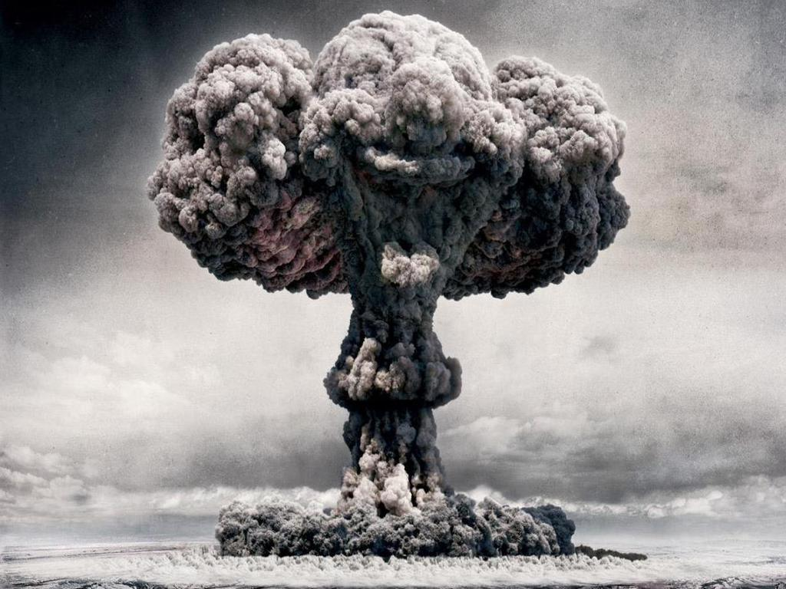
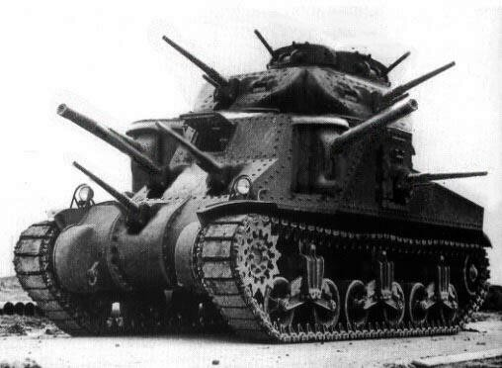

Selling War
Michael Szalay
Humanities Core, Winter 2014

Slide 2
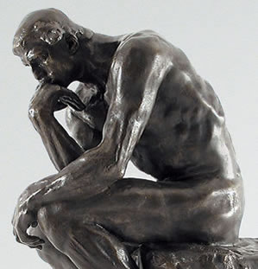
Texts and Contexts
Where do ideas for stories come from?
What is the purpose of a story? Is it just to entertain?
What do producers want from their stories? What do stories want from their consumers?
What is the difference between a commercial and a TV drama?
Assumption: Stories are made to act upon the world, in different ways, and in different contexts.

Slide 3
What is the difference between “quality” and “commercial” TV?
Showtime is a pay subscription service, and is commercial free.
Broadcast TV is free to the consumer, but sells the consumer (her eyeballs) to advertisers. Pay services sell the consumer a product, directly.
Networks like Showtime and HBO air “private” and unregulated culture
Their programming circumvents FCC regulations; it contains “adult” themes and language, and typically a lot more sex
“On 24, the torture scenes were the sex scenes. They were part of what made the show so repellent. Without ever acknowledging it, 24 harnessed the nudity and emotional exposure of torture to arouse the audience, to merge our bloodlust with something libidinal. In contrast, on Homeland, the literal, and often fairly graphic, sex scenes are the crucial sequences.”
            Emily Nussbaum, New Yorker, 11/29/13

Slide 4
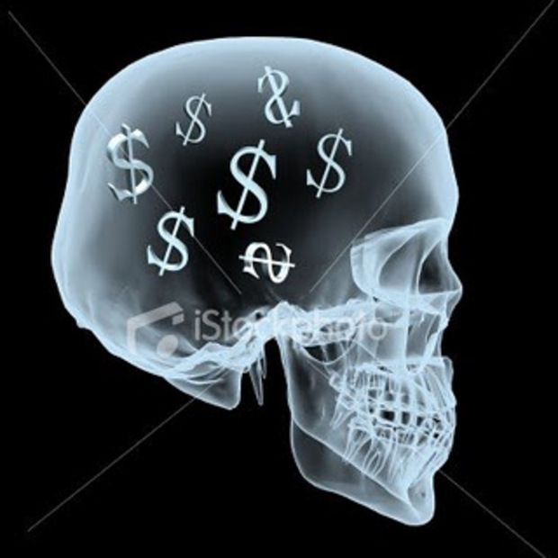
The difference between “quality” and “commercial” TV (continued)
Three-dimensional characters possessed of mixed motives and a rich interior life.
What do we know of Carrie Mathison’s past? Is she haunted by it?
What does Sgt. Nic Brody believe? What does he think and feel about radical Islam?
Carrie is in many ways a more complex character. Jack's a father, he's a husband, he's a secret agent who doesn't suffer fools and kind of punches them in the nose when he doesn't get his way. . .
Howard Gordon,
Mother Jones, 11/4/11
Does Jack Bauer possess an interior life? Is he haunted by his past?

Slide 5
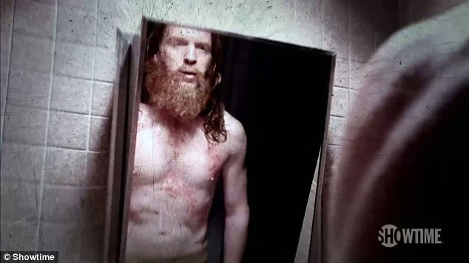
The Persistence of Scar Tissue
“Kiefer Sutherland’s Jack Bauer was tortured again and again, but he always bounced up, jack-in-the-box style, to waterboard on. . . . [On the other hand,] Neither Carrie (who bears scars from her time in Iraq) nor Nicholas (who survived a brutal, years-long imprisonment) can escape what was done to their bodies.”
            Emily Nussbaum

Slide 6

Is “quality” TV more “cinematic”? Is it more “literary”?
Cinematic production style: extended takes, slower pacing, awkward silences, artfully composed mis-en-scenes.
Fewer narrative “devices” or cheats. Character- versus plot- driven storytelling.
Does all of this contribute to greater “realism”?
Does all of this make “quality” TV quality TV? Is it actually better than broadcast TV?

Slide 7
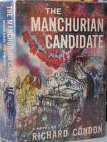
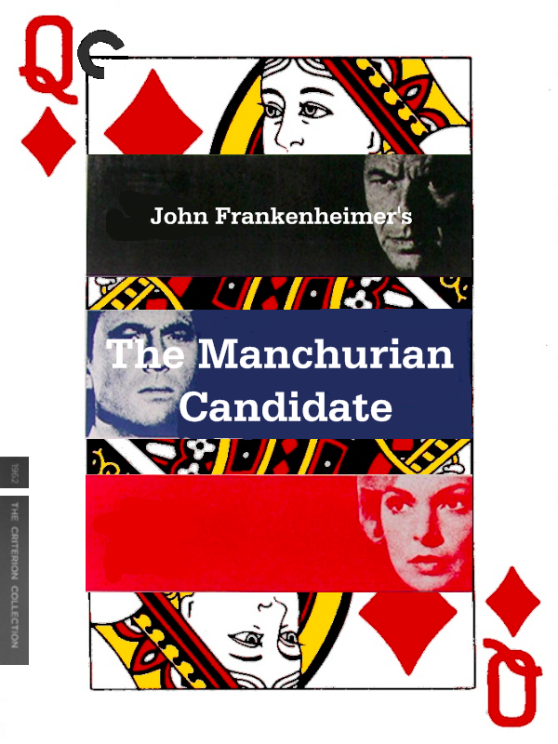
Homeland’s “literary” source material: The Manchurian Candidate (1959)
Translated into 19 languages and the basis of two major motion pictures, Richard Condon’s novel The Manchurian Candidate (1959) describes an American GI captured by the Chinese during the Korean War.
Raymond Shaw, the GI, returns to the States with his brains “not merely washed” but “dry-cleaned.”
Though he doesn’t realize it, he is the shooter in a Communist conspiracy—organized in China and led in the United States by his mother—to catapult his stepfather into the Oval Office.

Slide 8
Text Acting on Context:
Frank Sinatra starred in and helped produce The Manchurian Candidate (1962). He was friends with John F. Kennedy. Sinatra’s co-stars had all campaigned for Kennedy throughout 1960.
United Artists made the film. UA president Arthur Krim was national finance chairman of the Democratic Party.
Kennedy had read and loved the novel. He convinced Krim that it was OK to proceed with the politically explosive material.
One year after the release of the film, Lee Harvey Oswald kills Kennedy. Like Raymond Shaw, Oswald had spent time behind the Iron Curtain.
Oswald likely saw The Manchurian Candidate (playing two blocks from his apartment) just weeks before he shot Kennedy.
Wracked with guilt, Frank Sinatra pulled the film from circulation.

Slide 9
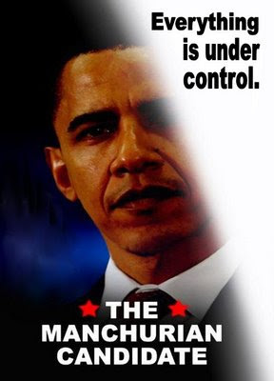
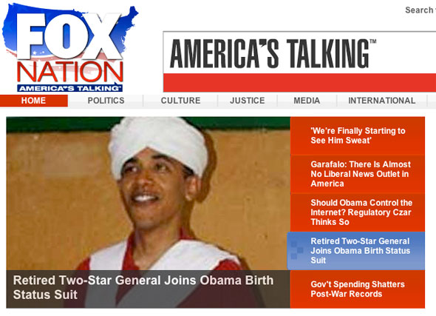
from The Manchurian Candidate to 24, Homeland, and the Birther Movement . . .

Slide 10

Context: Brainwashing and Subliminal Suggestion (where do desires and beliefs come from?)
In Brainwashing in Red China (1951), Edward Hunter writes that “Our age of gadgets and electronics had discovered the brain and we were learning how to manipulate it. This was something drastically new, like the splitting of the atom, that had come upon this earth in the middle of the twentieth century.”
In The Hidden Persuaders (1957), Vance Packard claims that Americans had “a packaged soul.” He describes advertising’s newfound reliance on “psycho-seduction” and “subliminal communication.”
In Every War But One (1959), Eugene Kincaid explains the defection of 21 GIs captured during the Korean War. He attributes their defection to “brainwashing,” and to the skillful application by the Chinese of “a highly novel blend of leniency and pressure.”

Slide 11
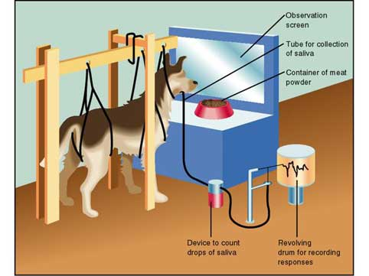
Conditioned Subjects
“You watch 24 and you know the entire thing is ridiculous, but you can’t help yourself. You want more. We’re like Pavlov’s dog, except rather than a bell, we’re triggered by that digital ticking clock and the Heemp! Heemp! Heemp! Opening each segment.”
        John Kass, The Chicago Tribune

Slide 12
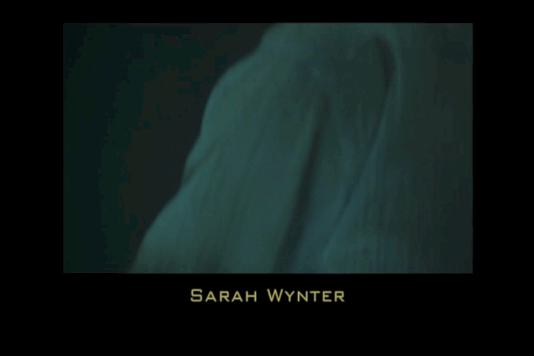
24 Season Two Opener

Slide 13
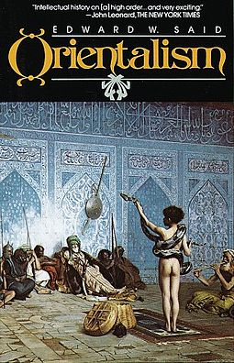
“Orientalism”
“. . . modern Occidental reactions to Islam have been dominated by a type of thinking that may still be called Orientalist. The general basis of Orientalist thought is an imaginative geography dividing the word into two unequal parts, the larger and ‘different’ one called the Orient, the other, also known as our world, called the Occident or the West.”
“So far as the United States seems to be concerned, it is only a slight overstatement to say that Muslims and Arabs are essentially seen as either oil suppliers or potential terrorists. Very little of the detail, the human density, the passion of Arab-Moslem life has entered the awareness of even those people whose profession it is to report the Arab world. What we have, instead, is a series of crude, essentialized caricatures of the Islamic world, presented in such a way as to make that world vulnerable to military aggression.”
Edward Said, The Nation, April 26, 1980

Slide 14
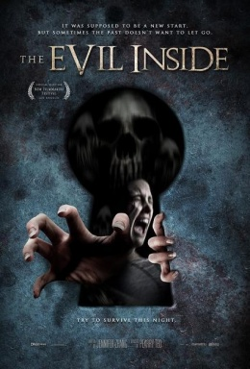
“The antagonism [between Good and Evil] is everywhere, and in every one of us. . . . Might not any inoffensive person be a potential terrorist? If they could pass unnoticed, then each of us is a criminal going unnoticed (every plane also becomes suspect), and in the end, this is no doubt true.”
Baudrillard
From Macro to Micro: The Evil Inside
“Discrete individuals and groups become, in the countersubversive imagination, members of a single political body directed by its head. The countersubversive needs monsters to give shape to his anxieties and to permit him to indulge his forbidden desires. Demonization allows the countersubversive, in the name of battling the subversive, to imitate his enemy.”
Michael Rogin, Ronald Reagan: The Movie, xiii

Slide 15

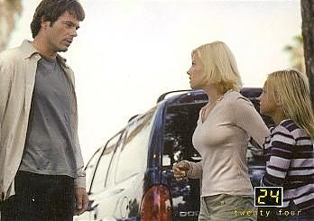
Inappropriate Desire
Jack’s Rage, and his Love for Kim
Video: “Jack and Kim”
https://www.youtube.com/watch?v=kUQmzQ90jFI

Slide 16
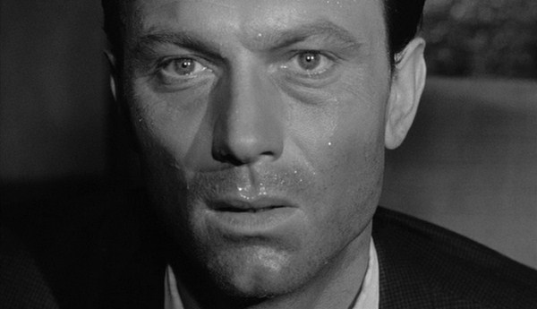
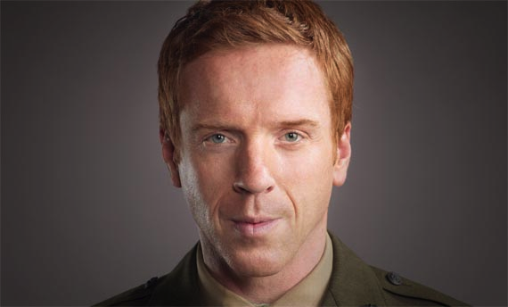
What kind of an agent is Nicholas Brody? Is he brainwashed or converted?
Raymond Shaw is not converted to any belief system.
Brody converts to Islam and comes to believe in Abu Nazir’s cause. Or does he?

Slide 17
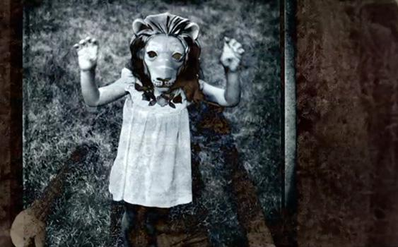
The Terrorist Within: Unconscious Processes
Opening: http://videos.nymag.com/video/Opening-Credits-Homeland#c=GPW04R137JDPW6CY&t=Opening%20Credits:%20%27Homeland%27
Commentary:https://www.youtube.com/watch?v=Bmt7rhwXHkI

Slide 18
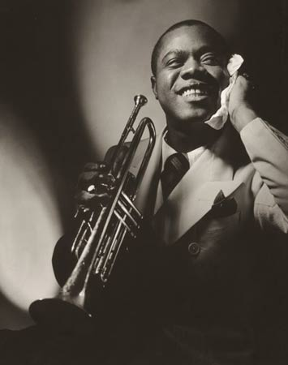
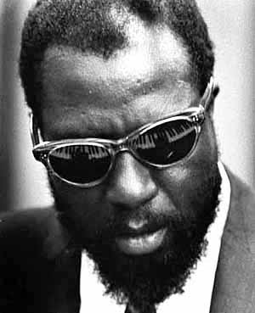
What role does jazz play on Homeland?
Carrie listens “to a version of Thelonious Monk's standard ‘Straight, No Chaser,’ while driving to a meeting at CIA headquarters in Washington. Monk was hospitalized at various points in his career due to an unspecified mental illness and there has been some debate about whether he could have had a schizophrenic or bipolar disorder. (In fact, jazz and schizophrenia have long been linked. It is argued that New Orleans cornetist Buddy Bolden, the ‘inventor of jazz,’ improvised the music he played as his schizophrenia did not allow him to read music, evolving ragtime into a more free form of music in the process.)”
The Guardian, 4/26/12
Louis Armstrong
Thelonious Monk

Slide 19
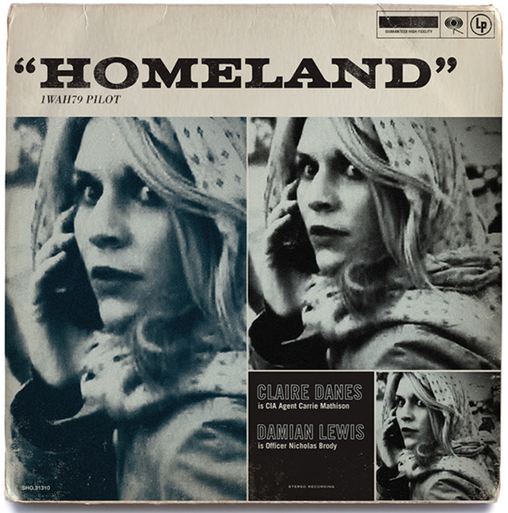
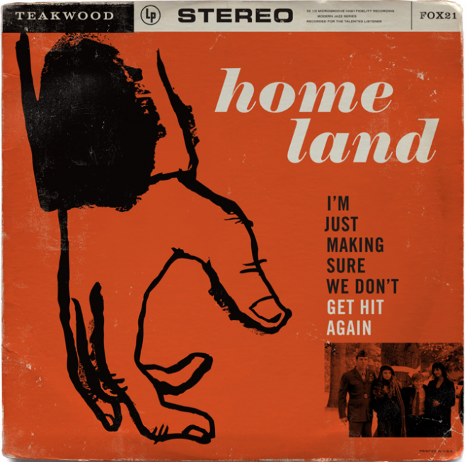
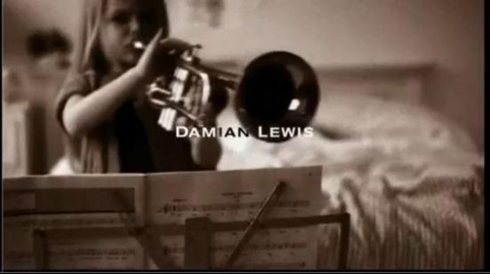
Jazz Codes
Clip: Carrie in Jazz Bar

Slide 20
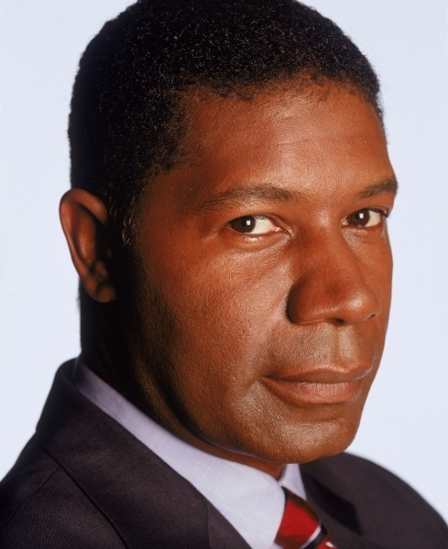
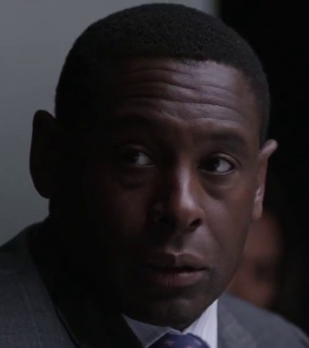
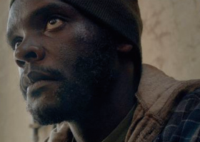
Black Authority and White Dispossession
Jazz Phrasings = A Terrorist’s code?
Black culture = Radical Islam?
African Americans = Aliens in our Midst?
Tom Walker
David Palmer
David Estes

Slide 21
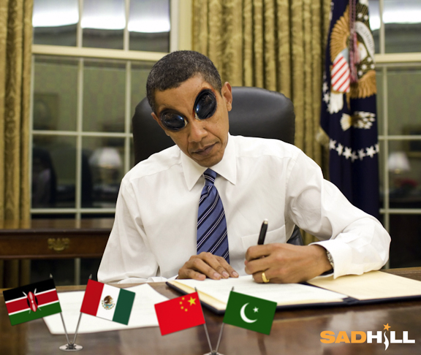
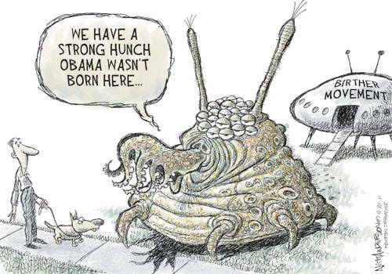
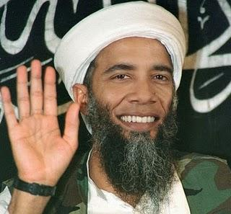
New Versions of American Racism

Slide 22
“He's a liberal, after his experience of war. I think he's a liberal. And a patriot. That may sound surprising to you, given what he tried to do in first season.”
Damian Lewis, The Atlantic, 9/28/2012
On Nicholas Brody
“While the show is very well done and suspenseful, it’s a show written and produced by liberals who blame America for Islamic terrorism and who tend to root for–and definitely sympathize with–the Islamic terrorists. . . . And it’s no coincidence that this is Barack Obama’s favorite show.”
          Debbie Schlussel
          http://www.debbieschlussel.com/54878homeland-a-show-for-liberals-who-root-for-islamic-terrorists-blame-america-first/

Slide 23
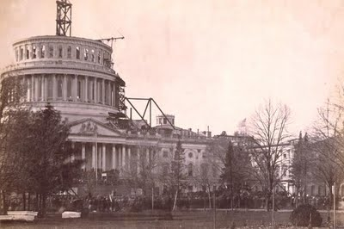
1) Abu Nazir compels Nic Brody to assault/torture Tom Walker
2) Brody does so, and releases his rage. What is the ultimate source of that rage?
3) Nazir comforts a sobbing Brody; they are now united.
4) Brody contemplates Congress
Clip: Final Sequence

